Slide 1


Welcome Everyone!
We’ll be starting at 10:05 AM PDT

Slide 2
The National Research Platform
Fall Training Series
Mohammad Firas Sada
University of California, San Diego
San Diego Supercomputer Center

Slide 3
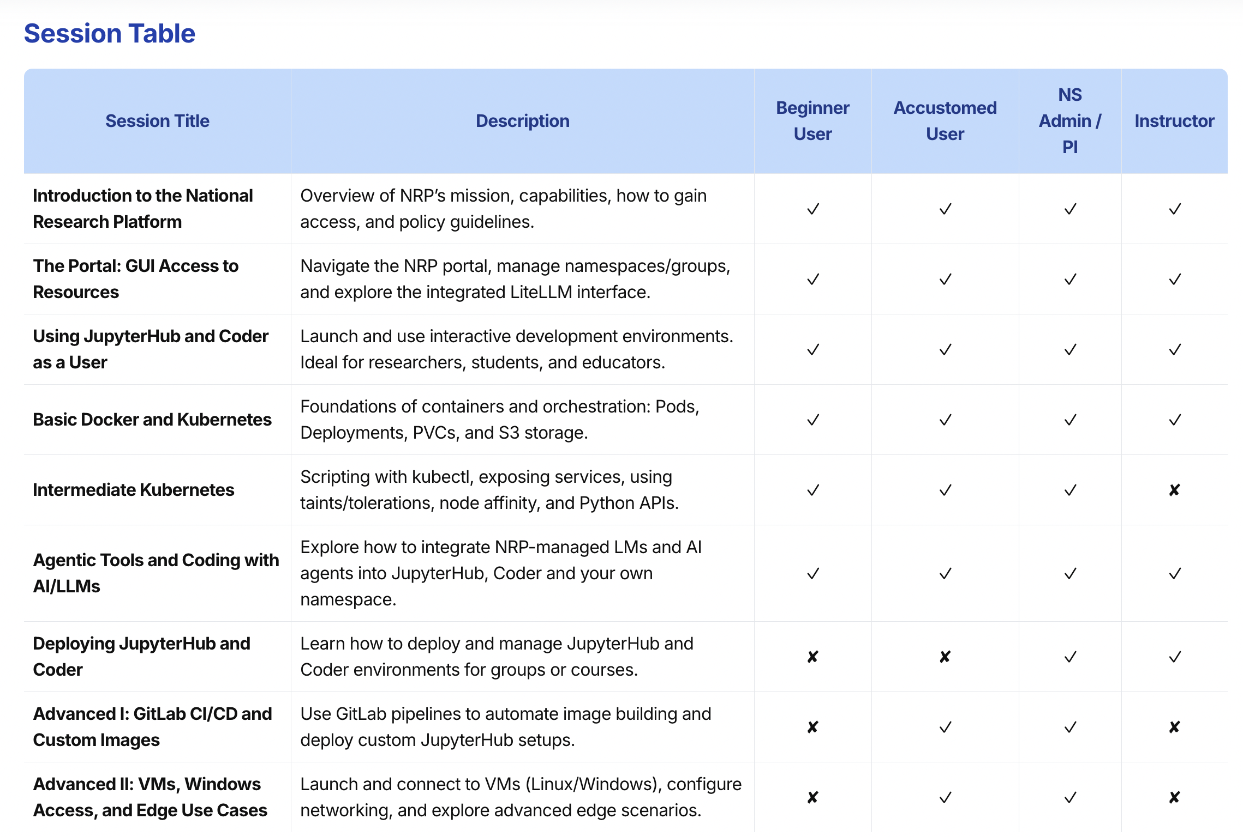

Slide 4
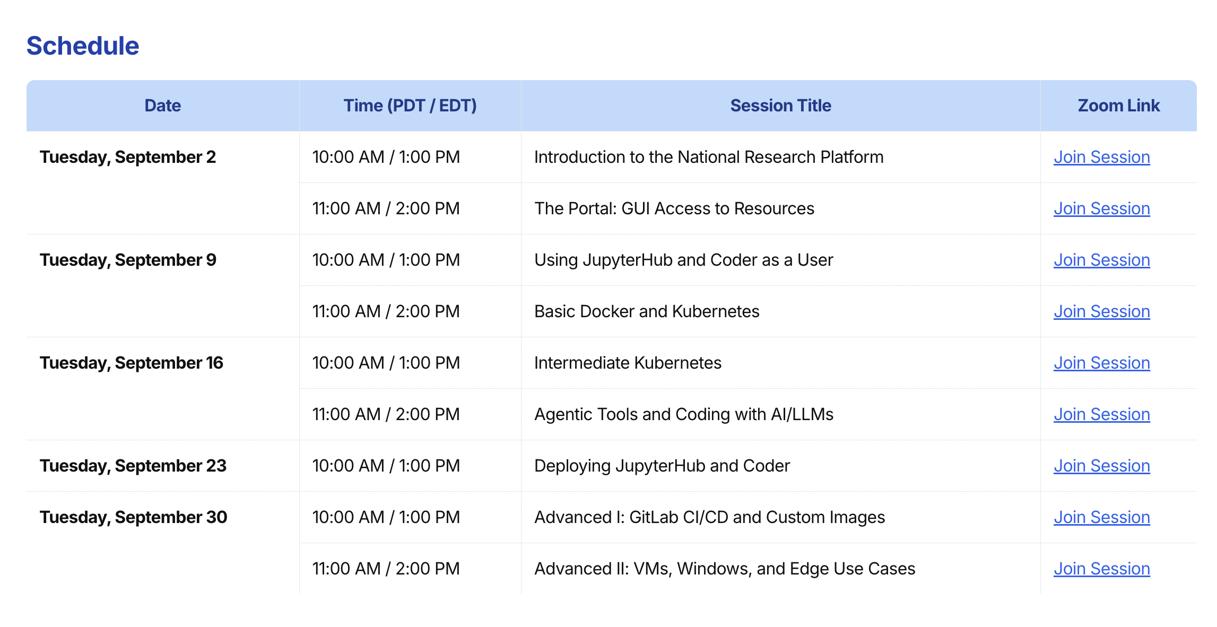
https://nrp.ai/training/

Slide 5
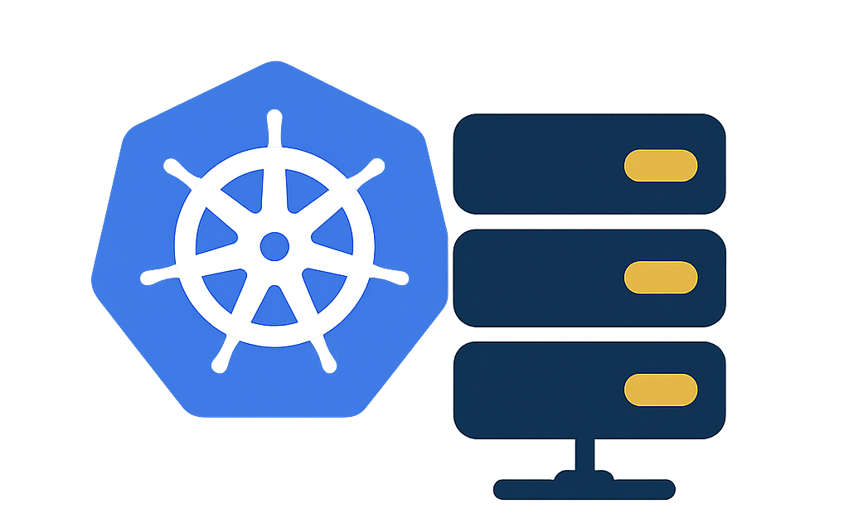
Introduction to the National Research Platform
National Research Platform Fall Training Series

Slide 6
Challenges & Outlook
Current Challenges
Rising Demand: Growing reliance on cyberinfrastructure (CI) for research and education.
Access Inequality: Widening gap between institutions with and without CI resources
Architectural Fragmentation: Post-Moore’s Law era complicates domain science adoption.
Future Outlook
Equity Focus: Prioritize CI access for all institutions.
Universal Connectivity: Connect educational institutions to advanced CI.
Talent Empowerment: Build environments for collaboration.
Global Leadership: Invest holistically in CI to drive innovation and competitiveness.

Slide 7
The National Research Platform
The National Research Platform is a partnership of more than 70 institutions.
Led by researchers at UC San Diego, University of Nebraska-Lincoln, and MGHPCC.
Includes contributions by the National Science Foundation, the Department of Energy, the Department of Defense, and many research universities and R&E networking organizations in the US and around the world.
NRP operates a primary Kubernetes distribution cluster with hardware spanning across 3 continents, called Nautilus.

Slide 8
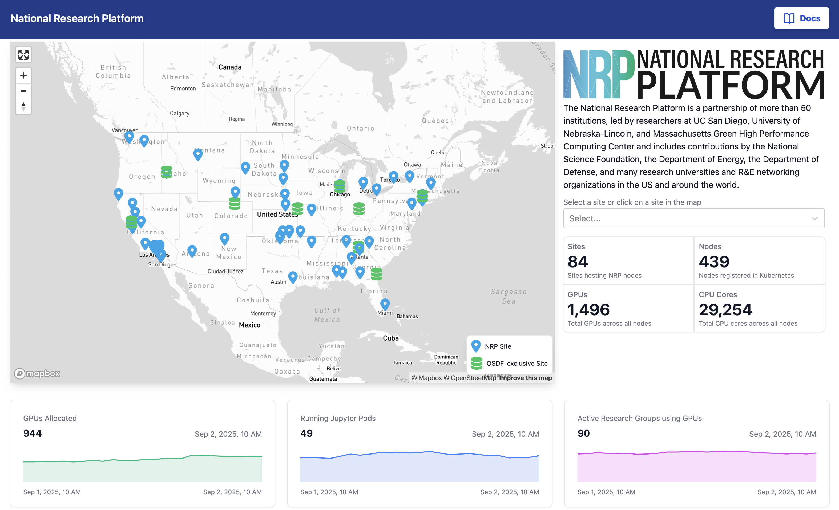
https://dash.nrp-nautilus.io/

Slide 9
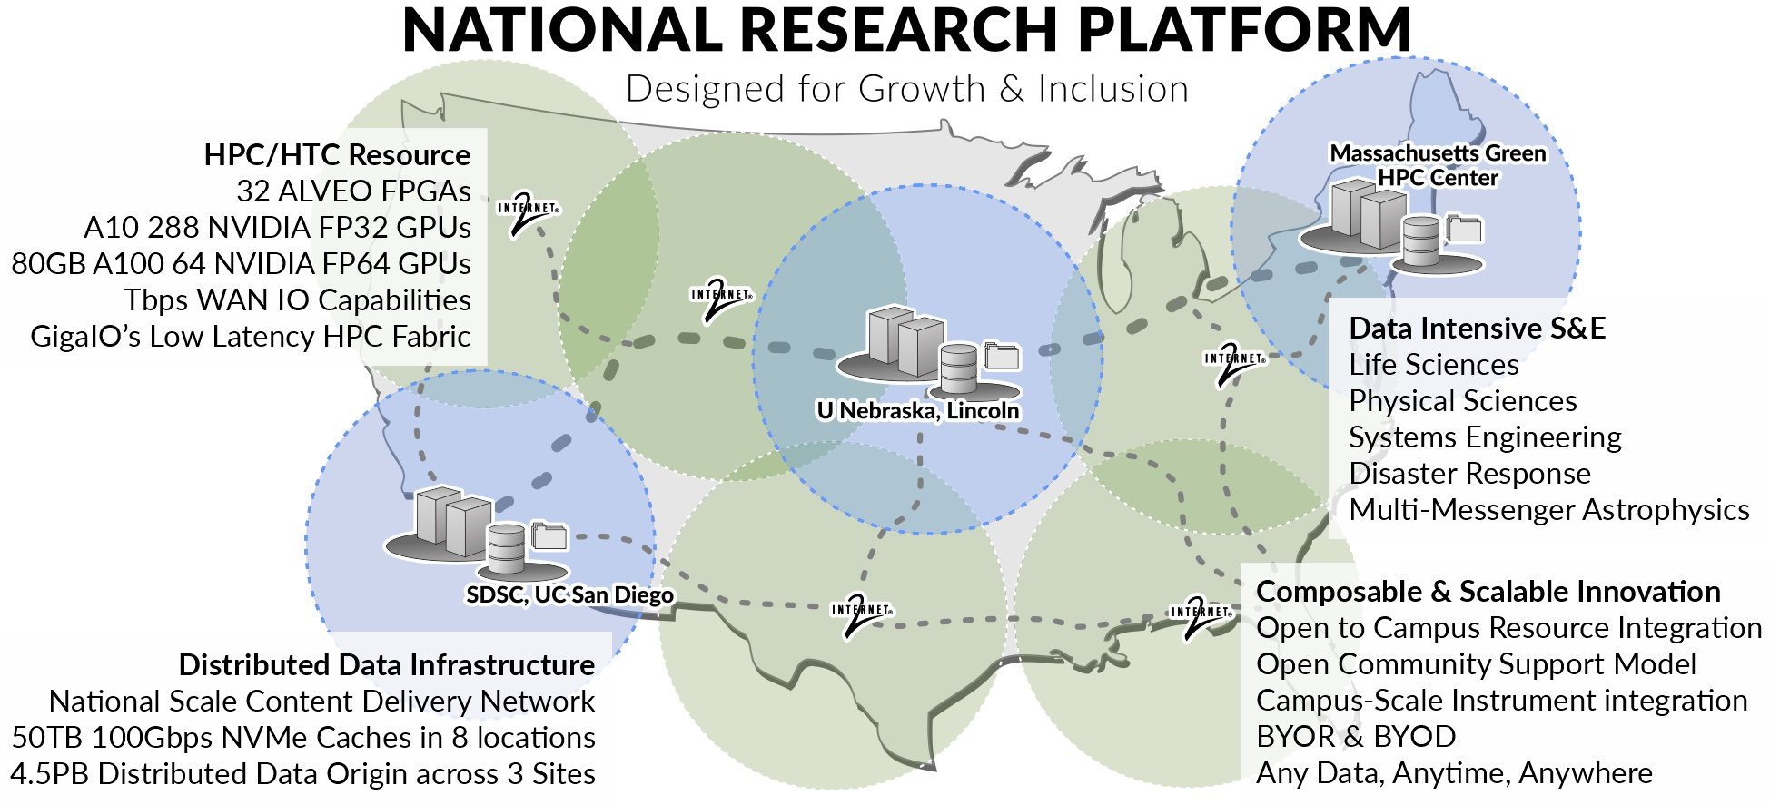

Slide 10
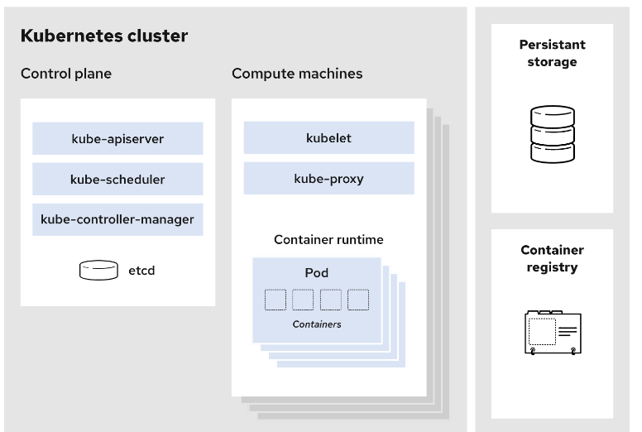
The Nautilus Cluster
Nautilus is a Kubernetes cluster
Control plane: Manages the cluster and the worker nodes
Worker Nodes: Maintain running pods and provide Kubernetes runtime environment
Has been in continuous operation for 6 years.
Various storage options like CephFS; CvmFS; S3; advanced monitoring tools like PerfSONAR; traceroute; Prometheus.
Diverse computation and data tools: JupyterHub; WebODM; GitLab; Nextcloud; Overleaf.
Collaboration and communication: Jitsi; EtherPad; Hedgedoc; SyncThing.
430+ nodes; 1400+ GPUs; 50+ FPGAs; Bluefield 2 SmartNICs; SmartSSDs; programmable Tofino switches….

Slide 11
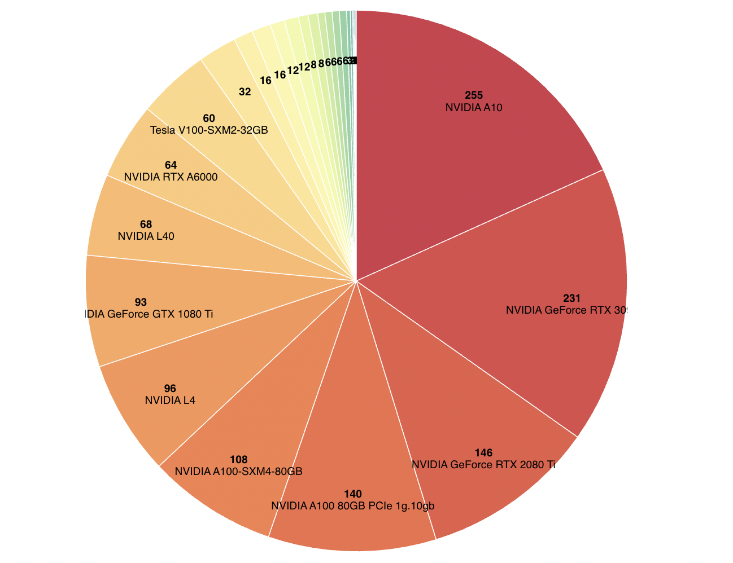
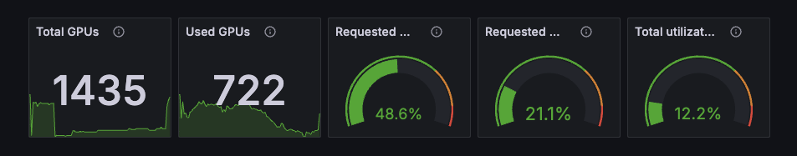
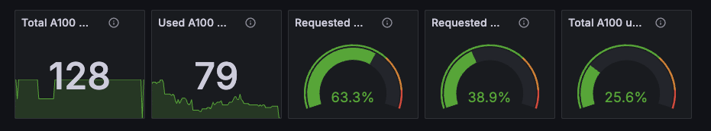
Hardware on Nautilus
ARM + x86_64 Nodes
1400+ GPUs with various models
Good for training most of the ML models
4-8 GPUs / node: can request all of them
550 GB RAM
8 Qualcomm Cloud AI 100 Ultra Inference & Fine-tuning Cards:
1 card = 4 SoCs (System-on-Chip)
Each SoC capable of running 25B Param LLM with out-of-the-box config
Provisioned via k8s device plugin
~600 RTX/GTX “Gaming” GPUs
https://nrp.ai/viz/
https://grafana.nrp-nautilus.io/

Slide 12
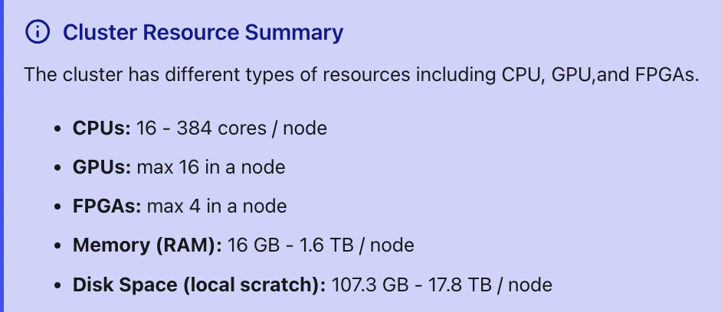
Hardware on Nautilus
ConnectX-6 NICs, P4-programmable Tofino Switches
32 P4-programmable Xilinx Alveo U55C FPGAs
16 BittWare 520N-MX Stratix FPGAs
3 Xilinx Alveo SN1000 FPGAs
7 NVIDIA Bluefield 2 DPUs
2 Xilinx U.2 FPGA-powered SmartSSDs
Kubernetes cluster with Multus, Calico and ESnet SENSE support.
+ Agilex7-M FPGAs + Various Types of Hardware
https://nrp.ai/viz/resources

Slide 13
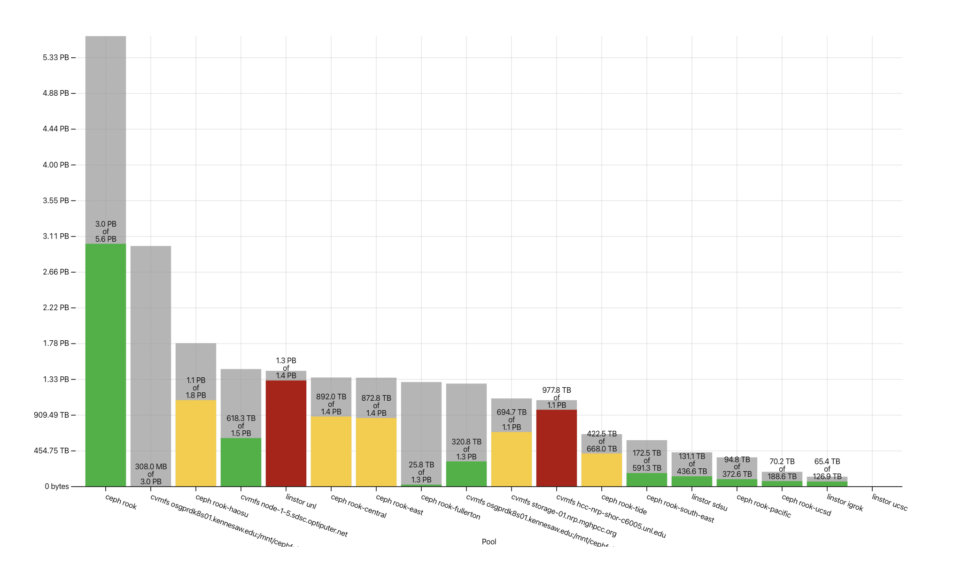
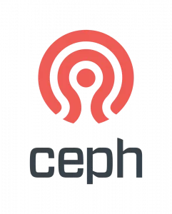
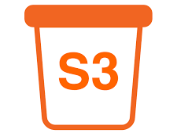


Storage Options on Nautilus
Ceph File System → Ceph FS → ReadWriteMany PersistentVolumes
Ceph Rados Block Device → Ceph RBD → ReadWriteOnly PersistentVolumes
Linstor Block → ReadWriteOnly PersistentVolumes
S3 Compatible storage → Bucket Endpoints
Open Science Data Federation → OSDF

Slide 14
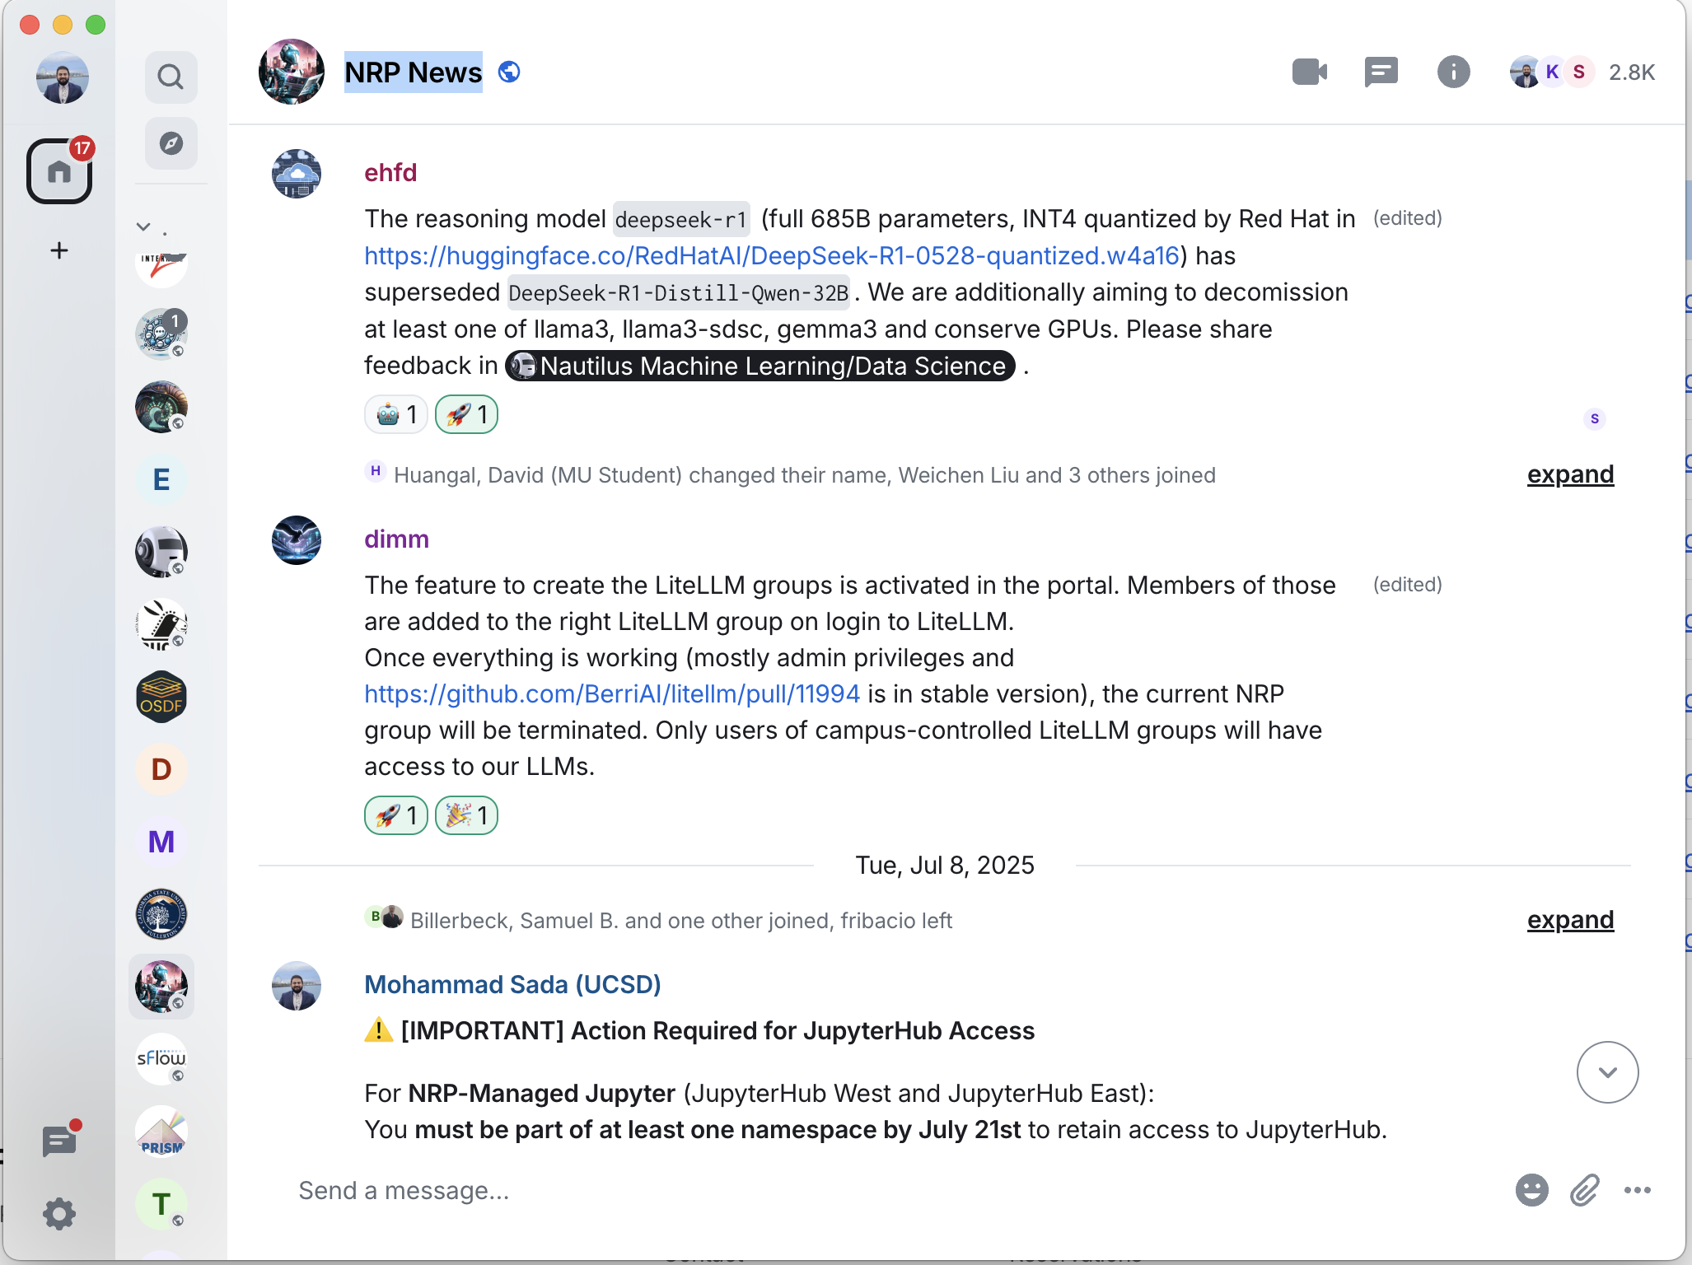
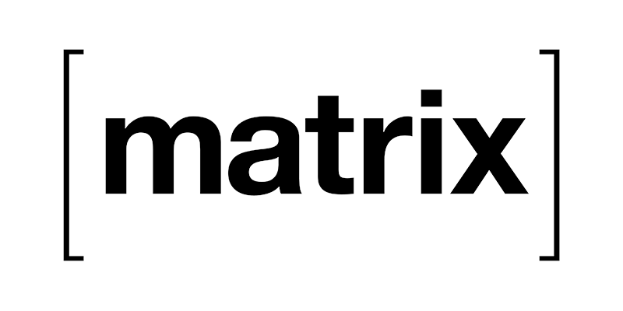
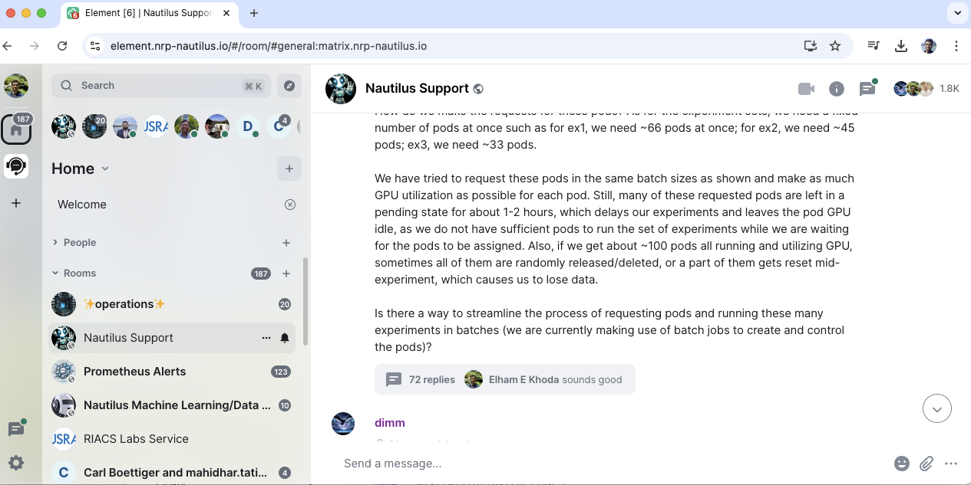
User Support
NRP hosts a Matrix Server For info about joining: https://nrp.ai/contact/
We provide user support in Nautilus Support
We announce news in NRP News
Element Client is free cross-platform, we host a web version at: https://element.nrp-nautilus.io/

Slide 15

Using Nautilus and NRP
National Research Platform Fall Training Series

Slide 16
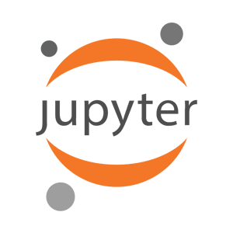

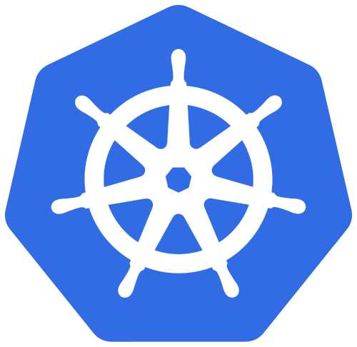
Using Nautilus and NRP
JupyterHub
Coder
Kubernetes

Slide 17
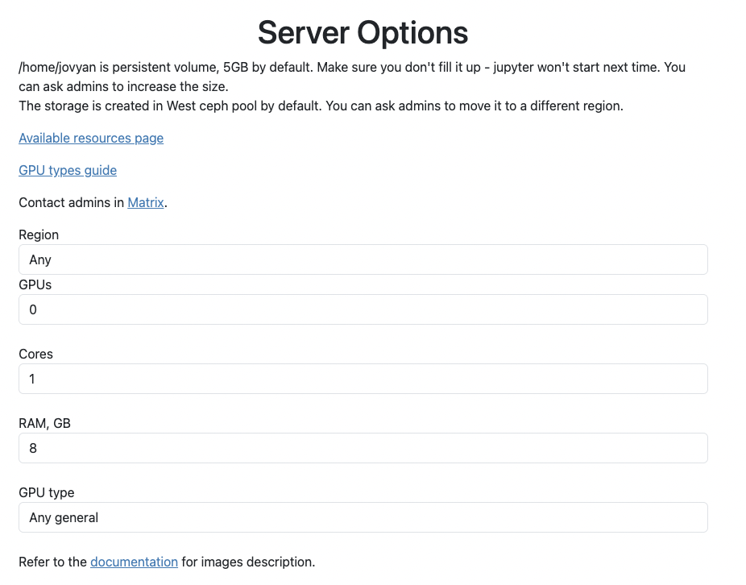
JupyterHub
https://jupyterhub-west.nrp-nautilus.io/
https://jupyterhub-east.nrp-nautilus.io/
We host two JupyterHub instances
Login via CILogon with your university credentials
You can choose resources like CPUs, GPUs, GPU type, RAM, etc
NRP provides several pre-built images
Read our docs to learn more: https://nrp.ai/documentation/userdocs/jupyter/jupyterhub-service/

Slide 18
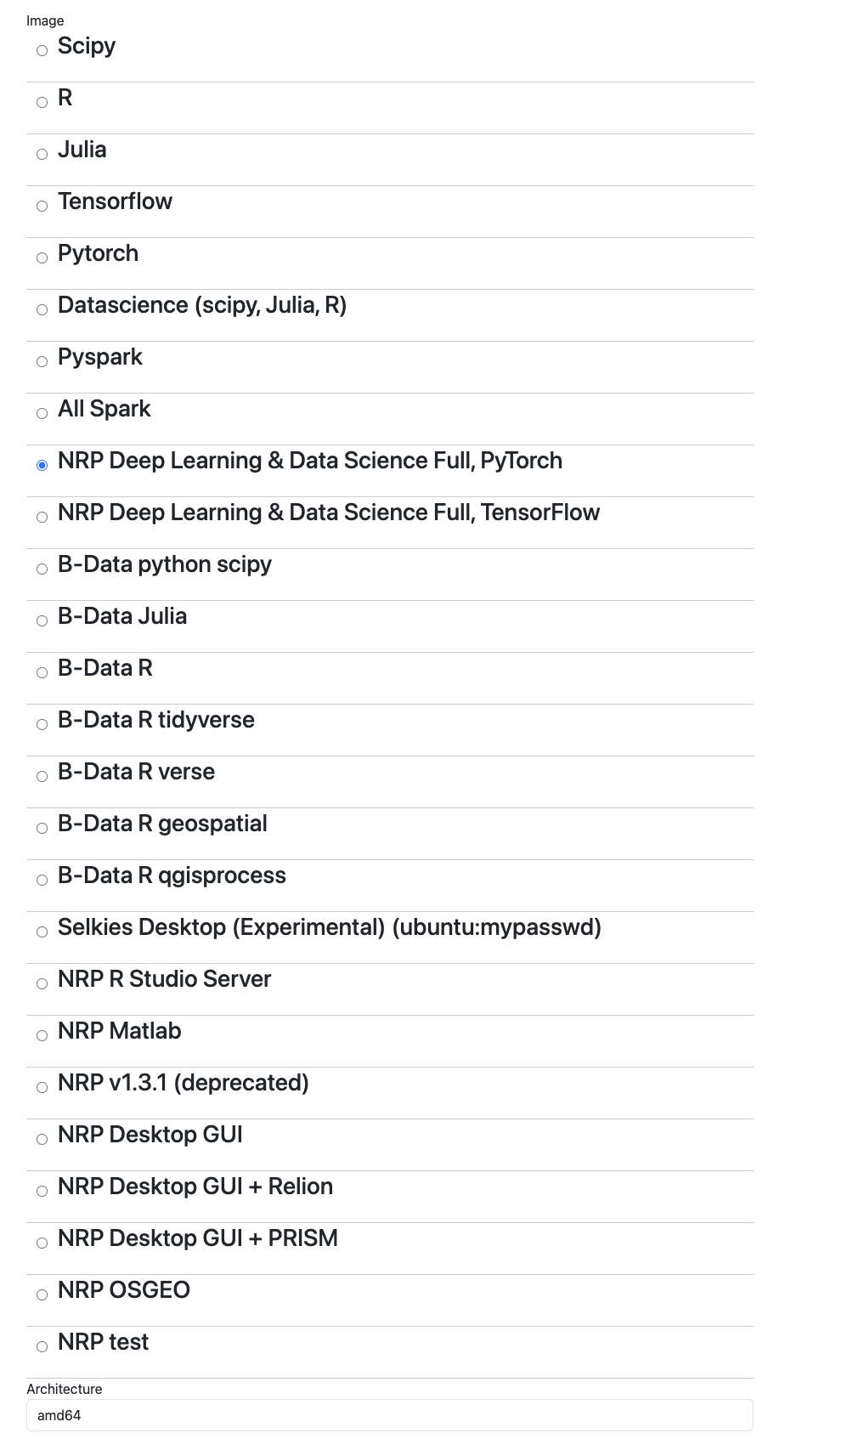
JupyterHub

Slide 19
Classroom Support
Interactive access via Jupyter is a foundational feature of PNRP
> 1000 users from 47 institutions used our JupyterHub
>100 namespaces have deployed their own JupyterHub instances
Broader Impact & Open CI Vision & Jupyter → Education as a focus on PNRP
NAIRR Classroom offering
NSF webinar with close to 500 attendees on 6/13/24
Students can login using CILogon with institutional credentials
Professor and TA will have admin status to create namespaces for classes
GPU nodes each with 8 A10 GPUs, 512GB of RAM, 2 AMD EPYC 7502 CPUs, and 8TB of NVMe
Support/Community interaction through Matrix channels
Direct ticketing system available for any issue needing longer follow ups

Slide 20
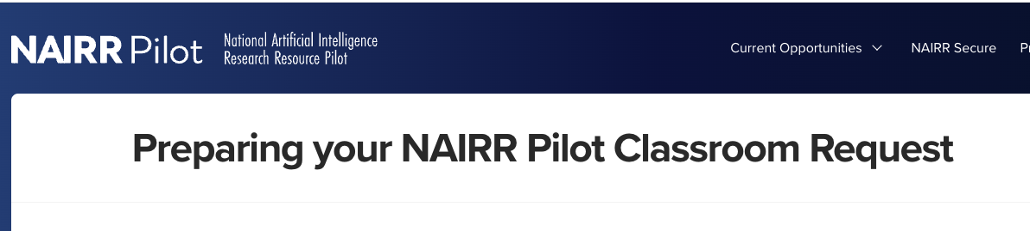
NAIRR Classroom Resources
We are offering PNRP resources via NAIRR Classroom pilot allocations
NAIRR Classroom allocations are already in progress (~10 allocations)
https://nairrpilot.org/opportunities/education-call

Slide 21
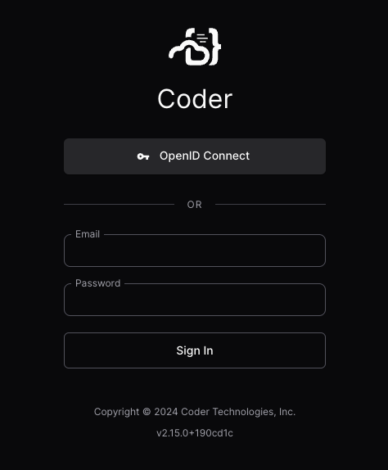
Coder
https://coder.nrp-nautilus.io/
We host a Coder instances
Login via CILogon with your university credentials
You can choose resources like CPUs, GPUs, GPU type, RAM, etc
NRP provides multiple templates
Read our docs to learn more: https://nrp.ai/documentation/userdocs/coder/coder/

Slide 22
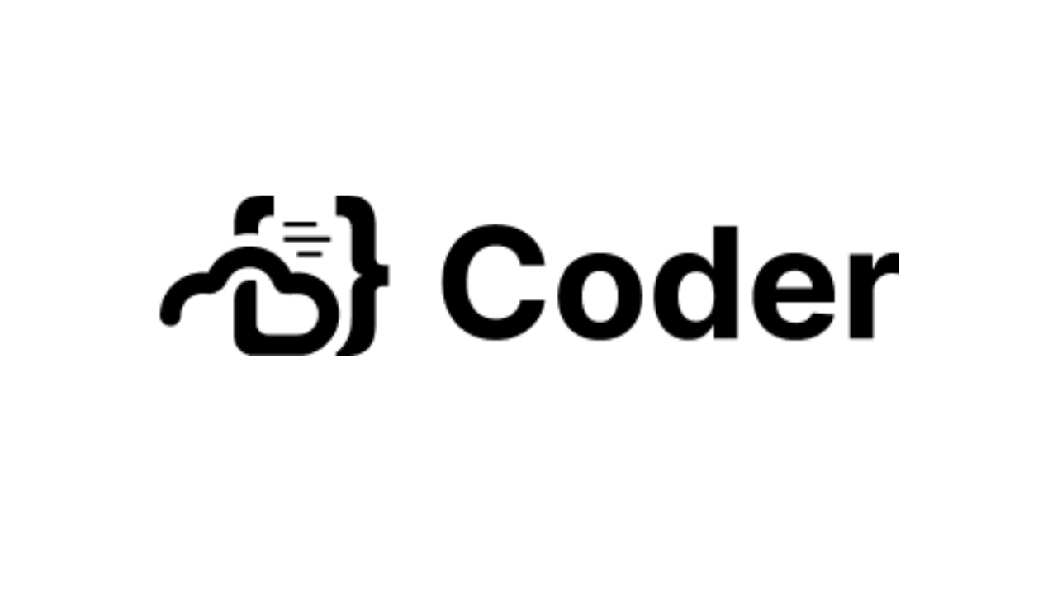
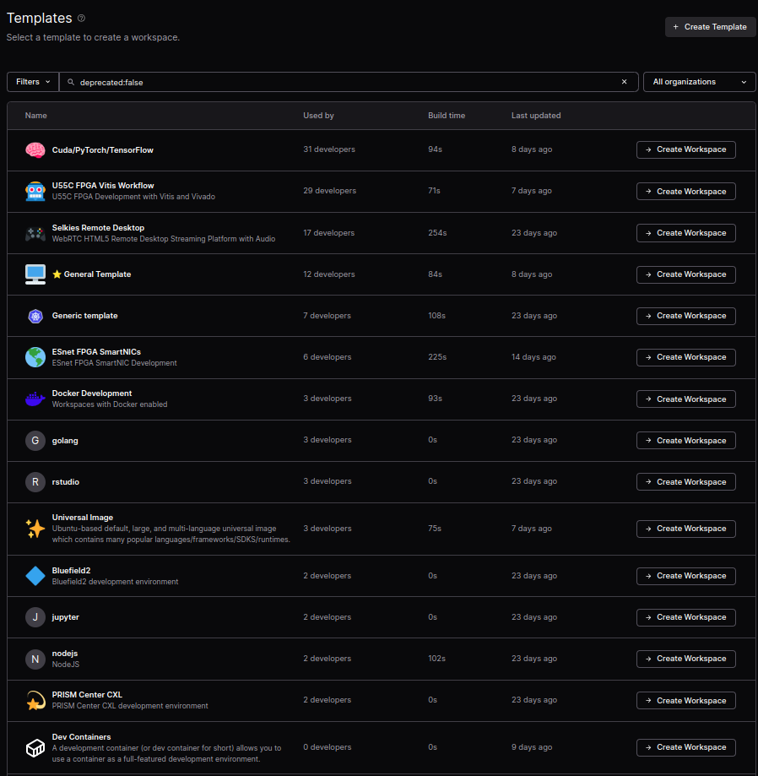
Access via Coder + FPGAs
Workspace = Personal Pod
Template = Image + Config
U55C FPGA Vitis Workflow
ESnet FPGA SmartNICs
Come preloaded with:
Xilinx Runtime Tools
Configuration to point to license server
Xilinx Tools (Vivado, Vitis, Vitis_HLS...)
Requests for Hardware
Read our Coder to learn more
https://docs.nationalresearchplatform.org/userdocs/coder/coder/

Slide 23
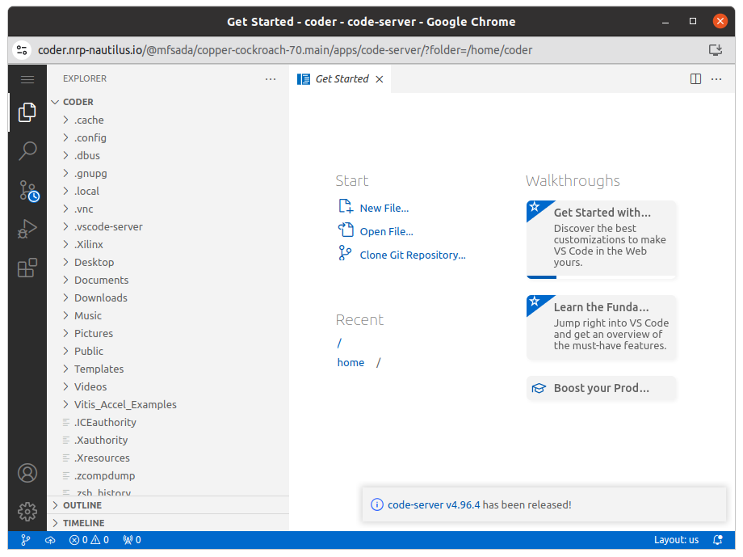
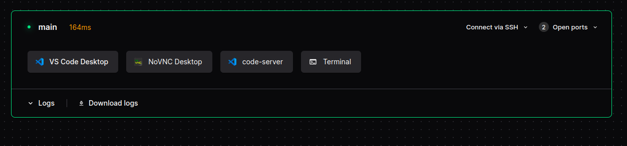
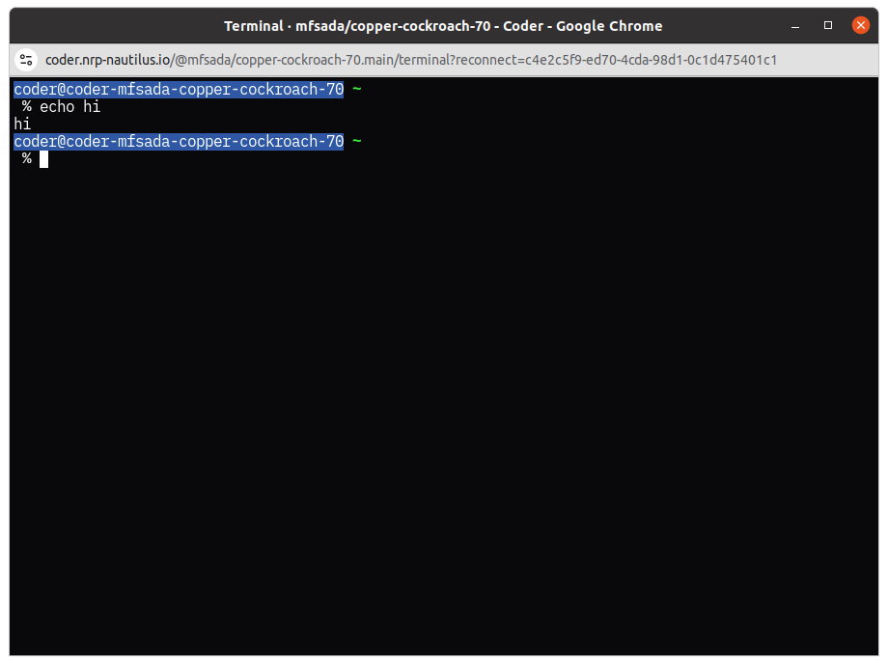
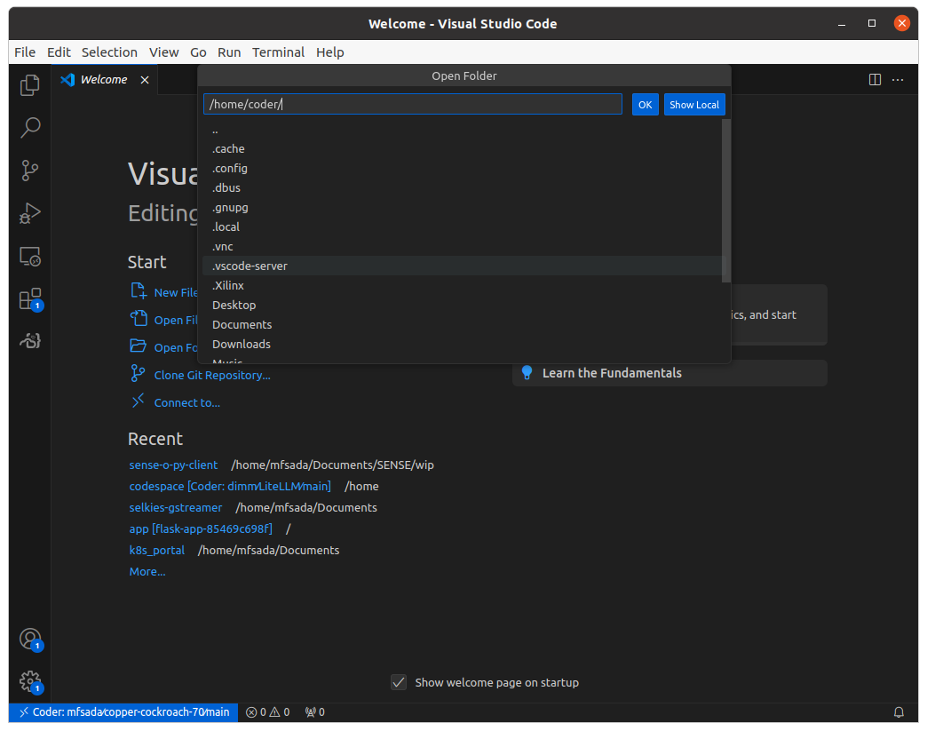
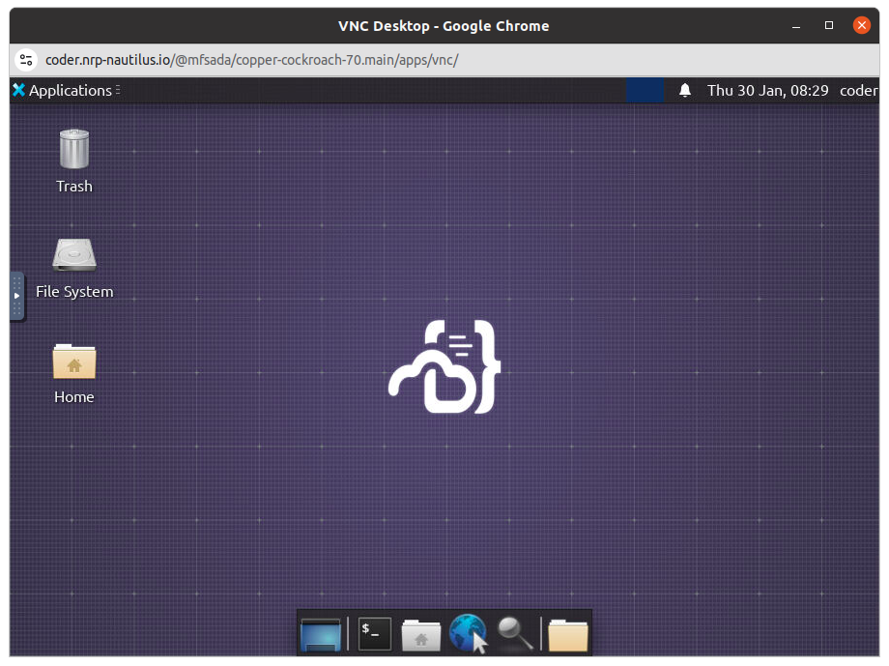
Coder
Features:
Custom Kubernetes Workflows with Terraform
(Pods, Deployments)
Remote Desktop in Browser
VS Code Desktop AND in Browser
Terminal in Browser
Persistent Personal SSH Key
Apps!

Slide 24
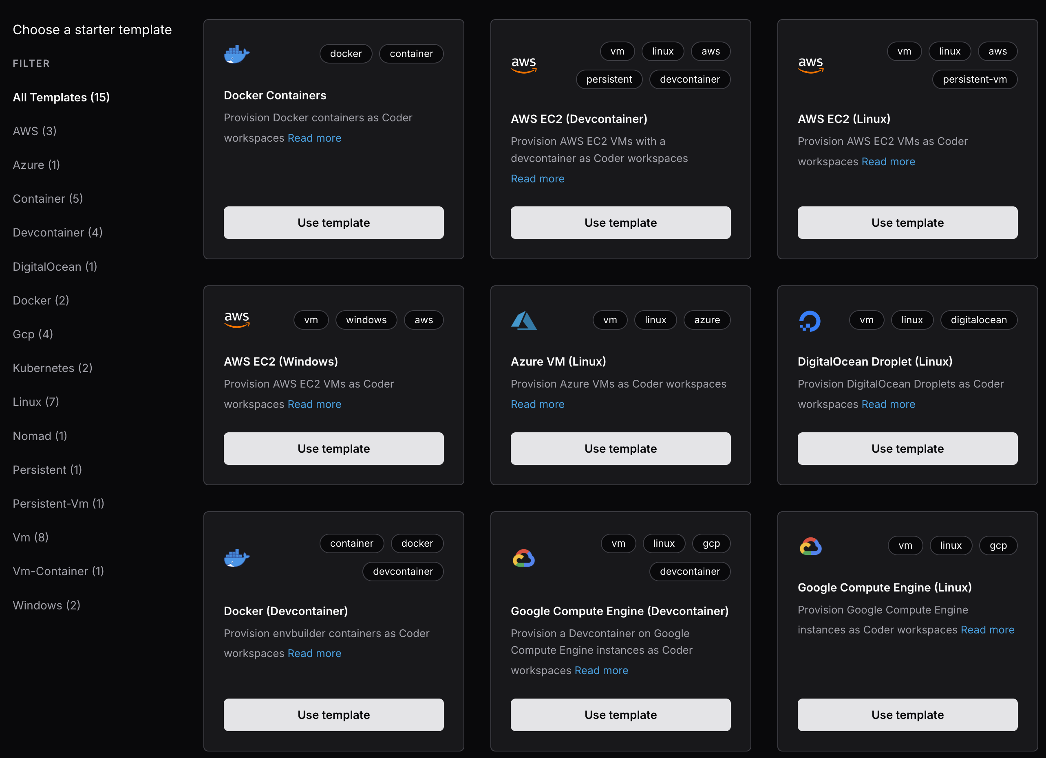
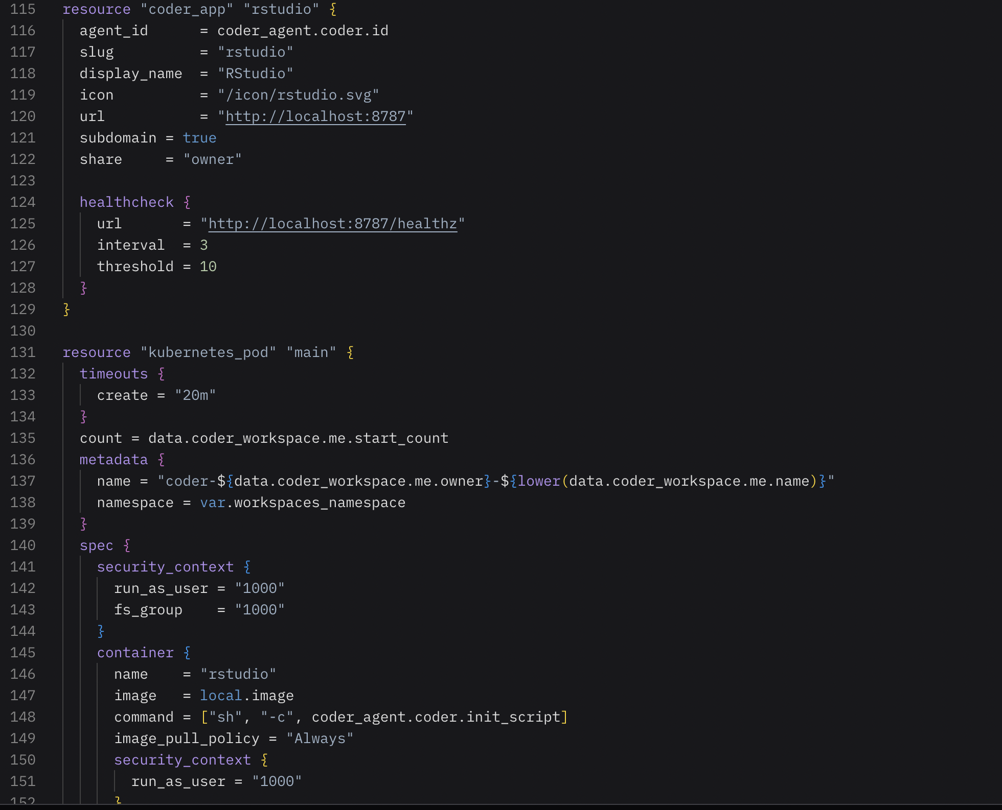
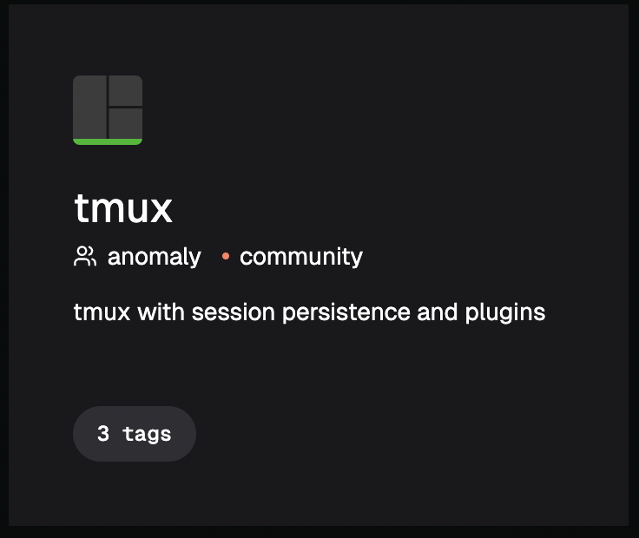
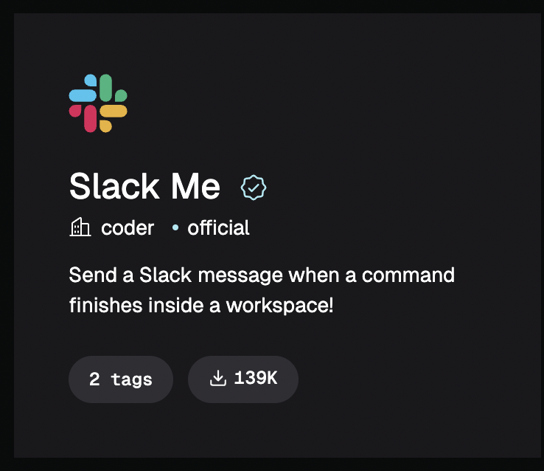
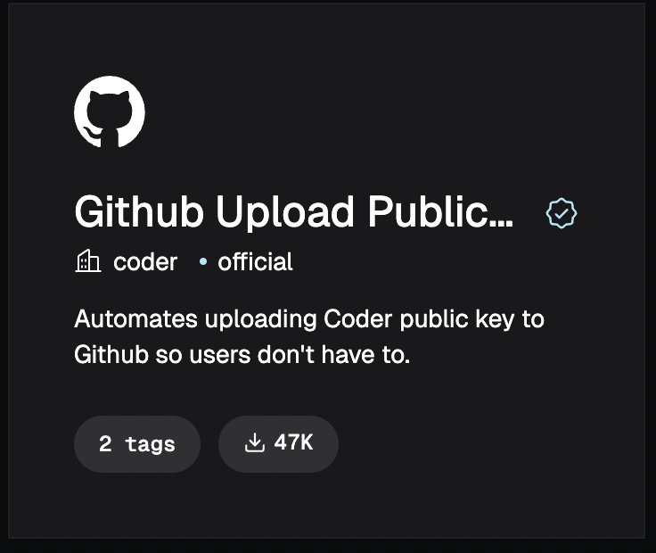
Terraform in Coder
Coder uses Terraform (HCL) not YAML

Slide 25
Kubernetes/k8s
API & CLI
Kubernetes API: used to create, modify, or delete objects
kubectl: main command-line tool to interact with Kubernetes
Defining Objects
Objects are described in YAML or JSON files
Core Object Types
Pod: smallest deployable unit (containers + resources + storage + policies)
Job: runs one or more Pods until they successfully complete (batch/HPC-like)
Deployment: manages long-running Pods, scaling, and updates
Other Useful Types
ReplicaSet, DaemonSet, CronJob, ReplicationController

Slide 26
Kubernetes/k8s
Namespaces
Logical partitions within a cluster
Separate users, projects, or workloads (like “queues” in HPC)
Resources (Pods, Jobs, Deployments) live inside namespaces
Scopes
Cluster-scoped: apply to the whole cluster (e.g., Nodes, StorageClasses)
Namespace-scoped: apply only within a namespace (e.g., Pods, Services, ConfigMaps)
RBAC (Role-Based Access Control)
Controls who can do what and where
Role → permissions inside a namespace
ClusterRole → permissions across the whole cluster
RoleBinding / ClusterRoleBinding → assign roles to users or groups

Slide 27
Kubernetes/k8s
Managing Storage in Kubernetes: Persistent Volumes
Persistent Volume Claim (PVC)
User’s request for storage (like requesting quota or project space in HPC)
Once created, a PVC can be mounted into Pods for use
Storage Classes (examples on NRP)
CephFS → RWX (ReadWriteMany), shared across Pods
Ceph RBD (block device) → RWO (ReadWriteOnce), single-Pod use
Linstor block → RWO, high-performance block storage
Ceph S3 → object storage, good for large datasets
Docs & More Info
https://nrp.ai/documentation/userdocs/storage/intro/

Slide 28
Kubernetes/k8s
apiVersion: v1
kind: PersistentVolumeClaim
metadata:
name: my-pvc
spec:
accessModes:
- ReadWriteOnce
resources:
requests:
storage: 10Gi
storageClassName: rook-ceph-block
apiVersion: v1
kind: Pod
metadata:
name: pvc-demo-pod
namespace: my-research-group
spec:
containers:
- name: app-container
image: busybox
command: ["sleep", "3600"]
volumeMounts:
- mountPath: /data # inside the container
name: my-storage
volumes:
- name: my-storage
persistentVolumeClaim:
claimName: my-pvc

Slide 29
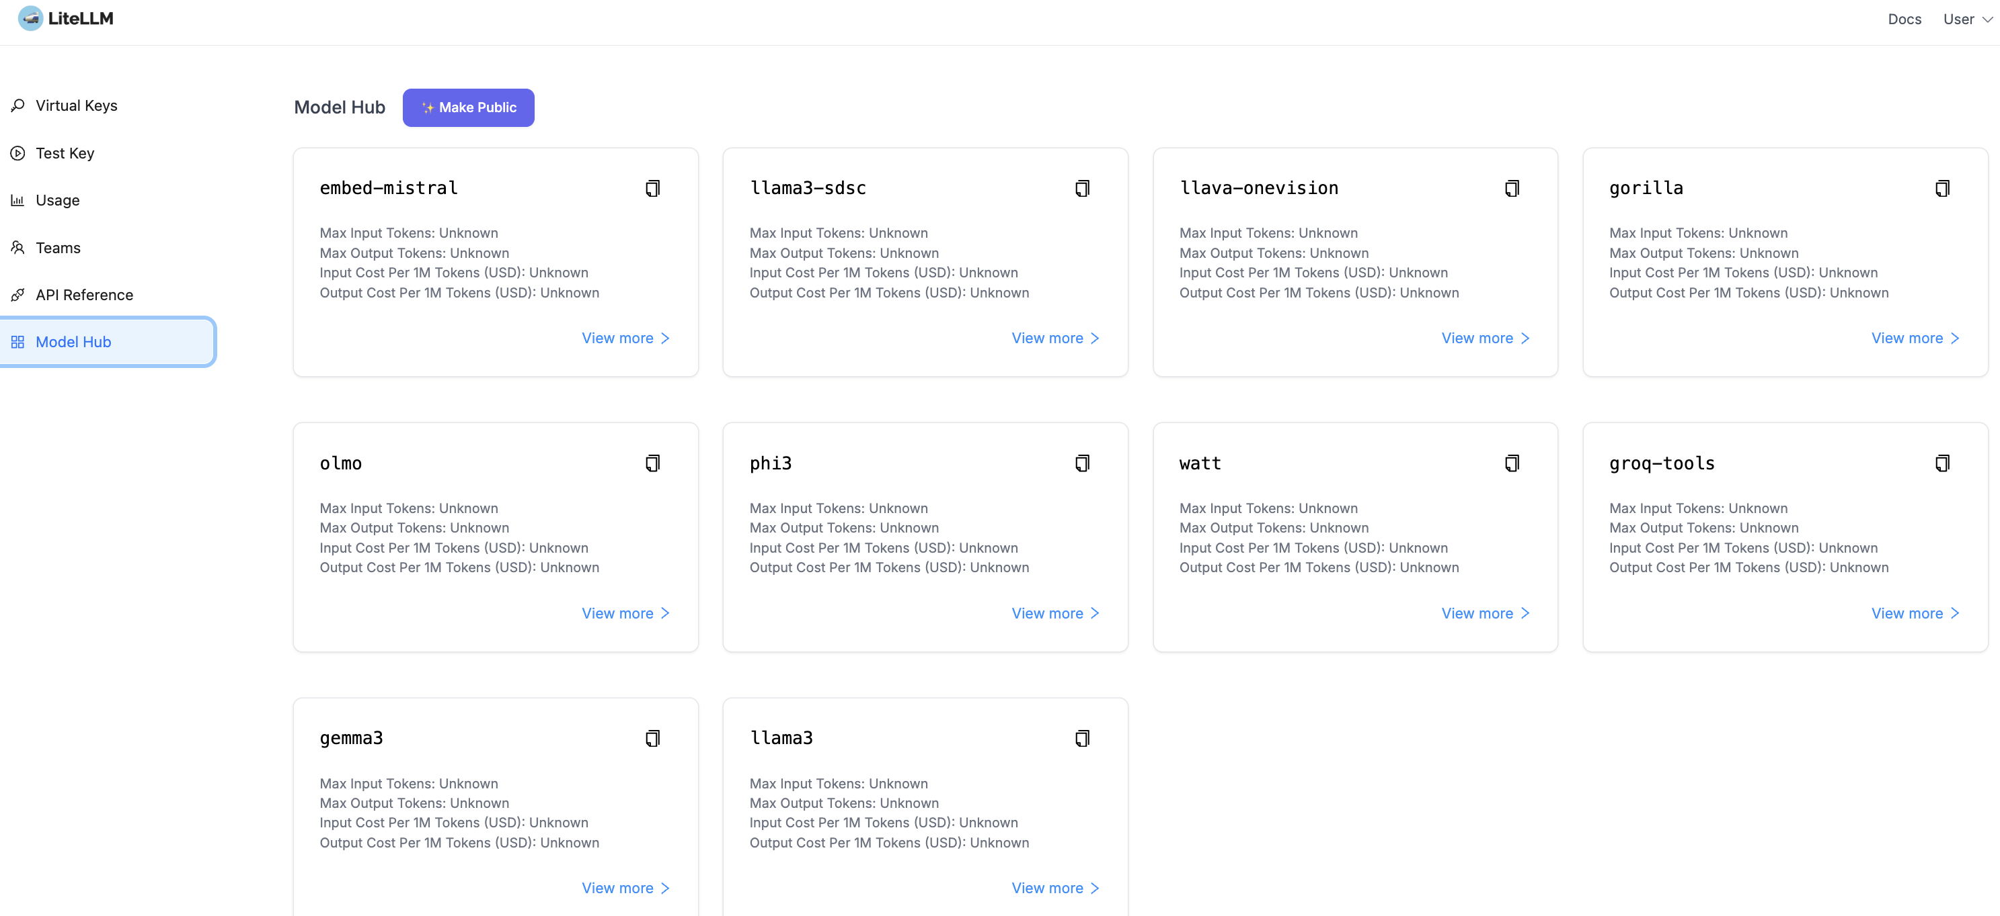
OpenAI-like Local LLM API – Safe & Secure
https://llm.nrp-nautilus.io/
Read about NRP-hosted LLMs (inference):
https://nrp.ai/documentation/userdocs/ai/llm-managed/

Slide 30

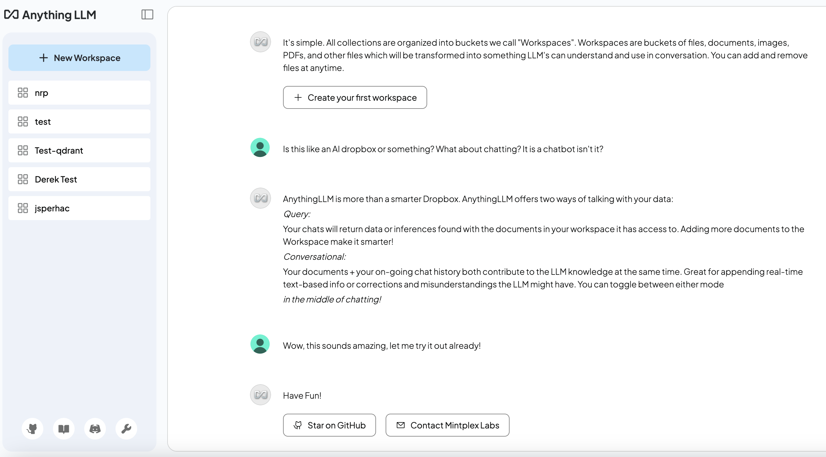
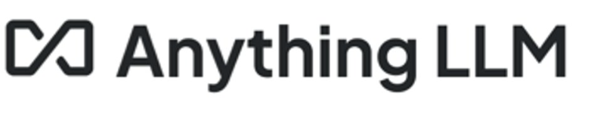
OpenAI-like Local LLM Chat – Safe & Secure
Read more about NRP-hosted chat UIs: https://nrp.ai/documentation/userdocs/ai/llm-managed/
https://librechat.nrp-nautilus.io
https://nrp-llm-chat.nrp-nautilus.io

Slide 31
Using Nautilus and NRP
JupyterHub
Coder
Kubernetes
To access any of these services, you need to be part of a namespace/group on: https://nrp.ai/namespaces/

Slide 32
Why Operators Care?
Heterogeneous Hardware at Scale ≠ Hyperscaler Problems
Unlike cloud providers with homogeneous fleets, Nautilus integrates 40+ types of devices (GPUs, FPGAs, SmartNICs, Tofino switches).
Operational Pain Points:
Firmware/Driver Hell: NVIDIA Bluefield DPUs vs. Xilinx FPGAs vs. Intel Tofino ASICs require custom kernels, conflicting dependencies.
Performance Fragmentation: Mixing 10G, 25G, 100G links across domains (ESnet, Internet2, campus networks) led to mixed throughput.
Control Plane: Kubernetes (Calico, Multus) + SENSE + P4 data planes created overlapping orchestration layers.

Slide 33

Measuring & Monitoring
Cloud Native University - North America 2025

Slide 34
Observability and Controllability with sFlow
Network-wide visibility through random packet sampling (1:N) + counter polling (interface stats, CPU, memory).
Captures interface counters, packet samples, and drop events from switches, routers, and nodes.
Host-Side Agent: hsflowd runs on every node, lightweight, reports: Interface traffic stats, dropped packets in kernel stack with function-level detail, TCP delay/loss/jitter via netlink/tcp_diag, GPU, container, and optical metrics (if available).
Analytics Engine: sFlow-RT: Processes sFlow data for:
DDoS detection, queue depth, and transit delay analysis.
Live dashboards (Grafana/Prometheus integration).
Event-triggered control (e.g., rate-limiting, ERSPAN).
Sub-second response to network anomalies.
InMon: Visualization and Control
Collects sFlow/NetFlow/SNMP/BGP from all devices.
Powers Traffic Sentinel: visualization, alerting, and dashboards.
Enables network-wide drop analysis, host tracing, and custom dashboards.
sFlow
hsflowd
sFlow-RT
InMon

Slide 35
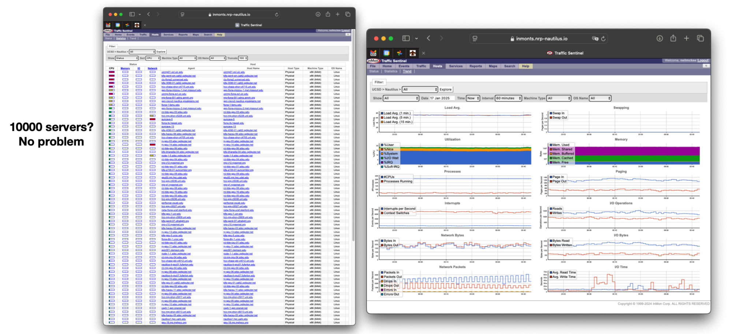
Observability and Controllability with sFlow
sFlow
hsflowd
sFlow-RT
InMon
Screenshots on NRP, Courtesy of InMon Corporation
Credit: Neil McKee, InMon, 2025

Slide 36
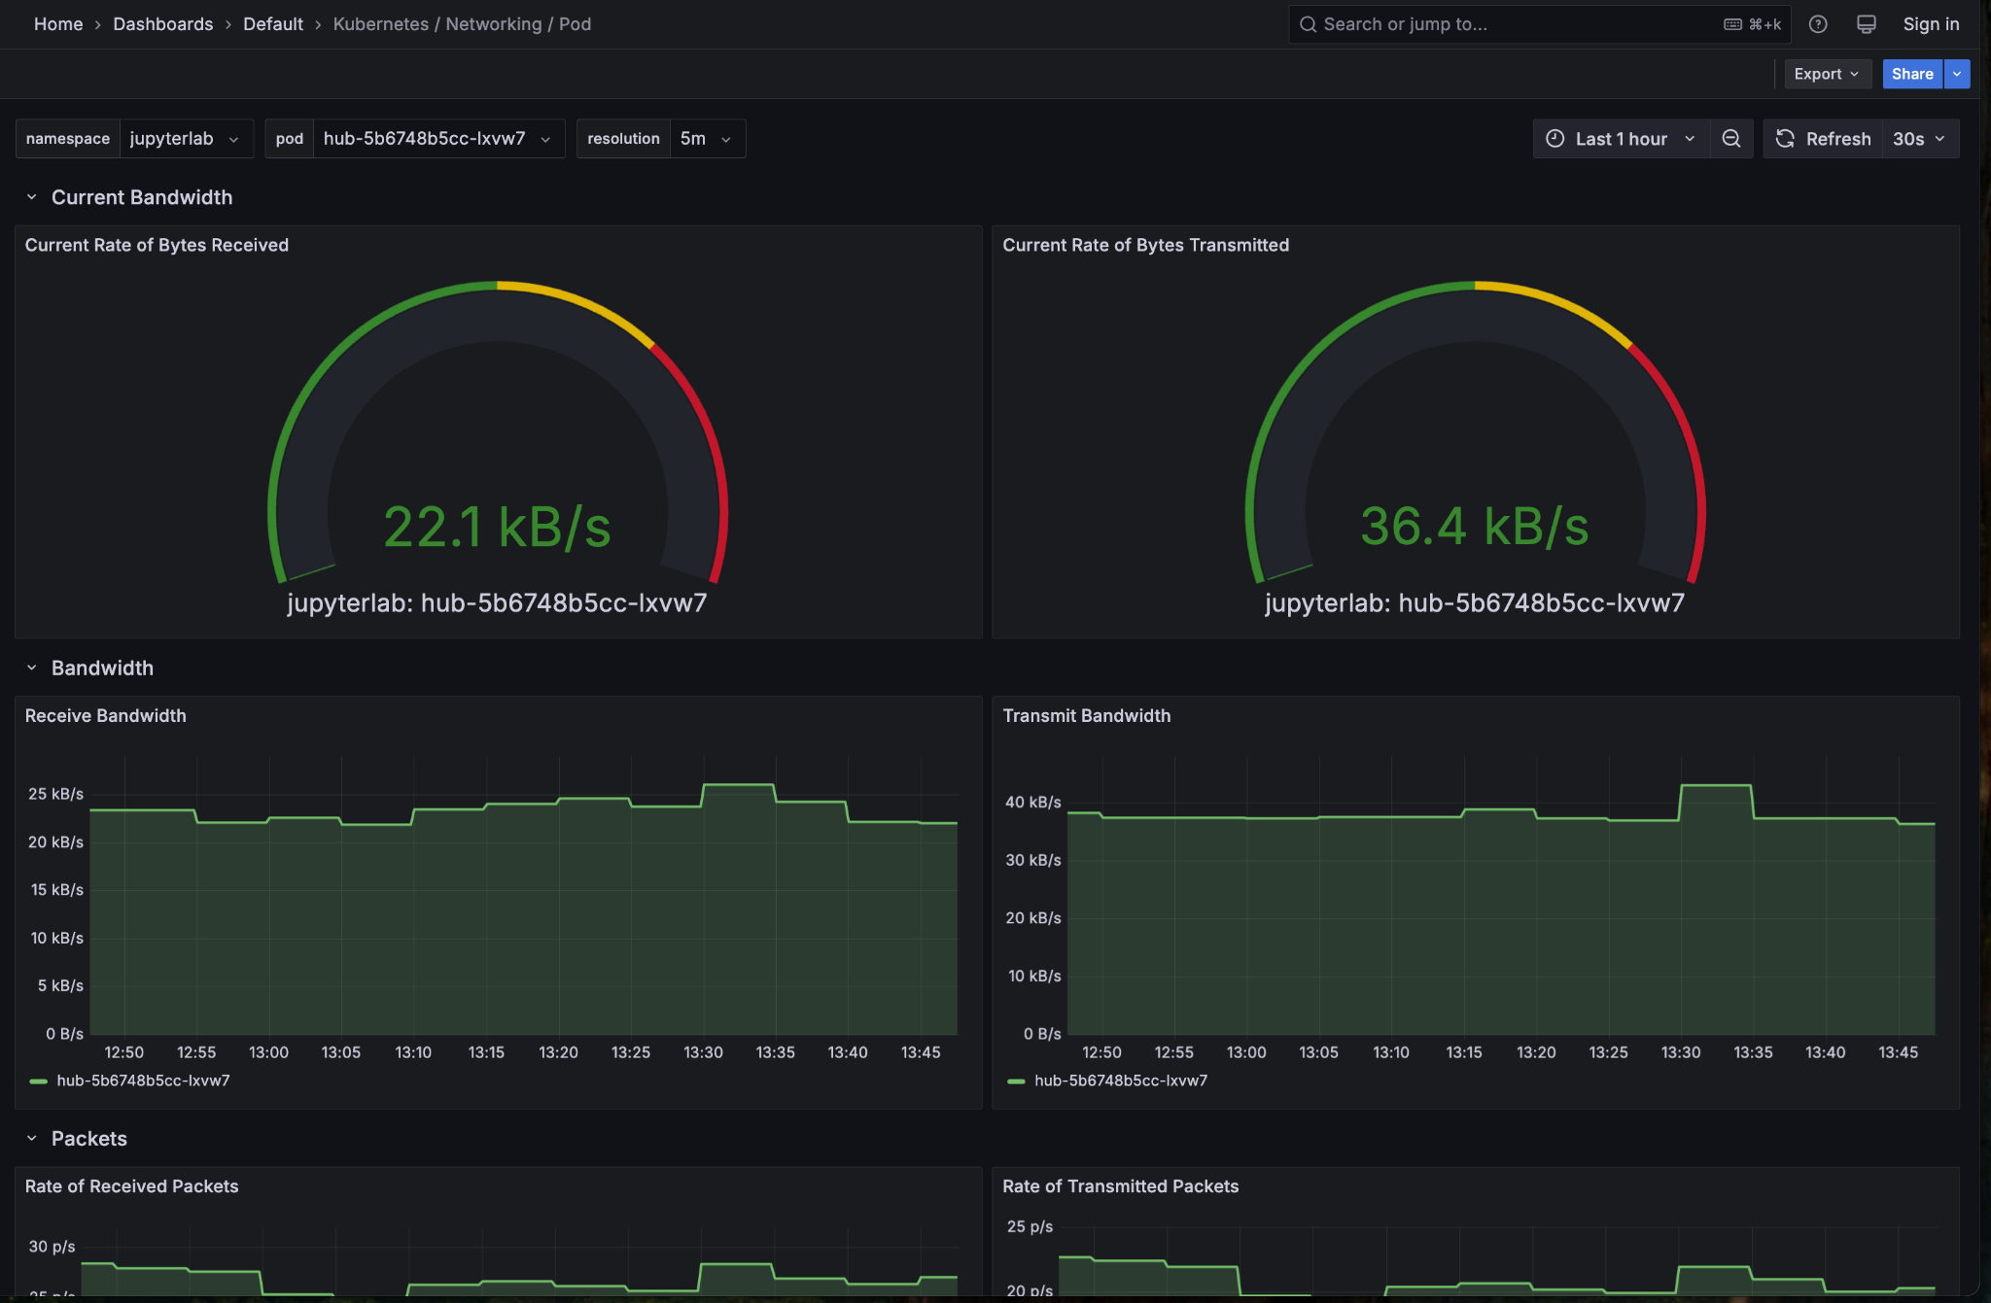
Prometheus & Grafana
Prometheus: Scrapes metrics from 425+ nodes, 1,400+ GPUs, and cluster services (Kubernetes, Ceph, LiteLLM, SeaweedFS, Synapse, etc.).
Exporters: node-exporter (Linux/Windows/MacOS), ceph-exporter, kube-state-metrics, and custom exporters for FPGA/DPU telemetry.
Thanos: Federates Prometheus data for global querying, compacts metrics, and stores them in object storage (Ceph/S3).
Grafana: 50+ dashboards for real-time and historical analysis.
https://prometheus.nrp-nautilus.io
https://grafana.nrp-nautilus.io
https://thanos.nrp-nautilus.io

Slide 37
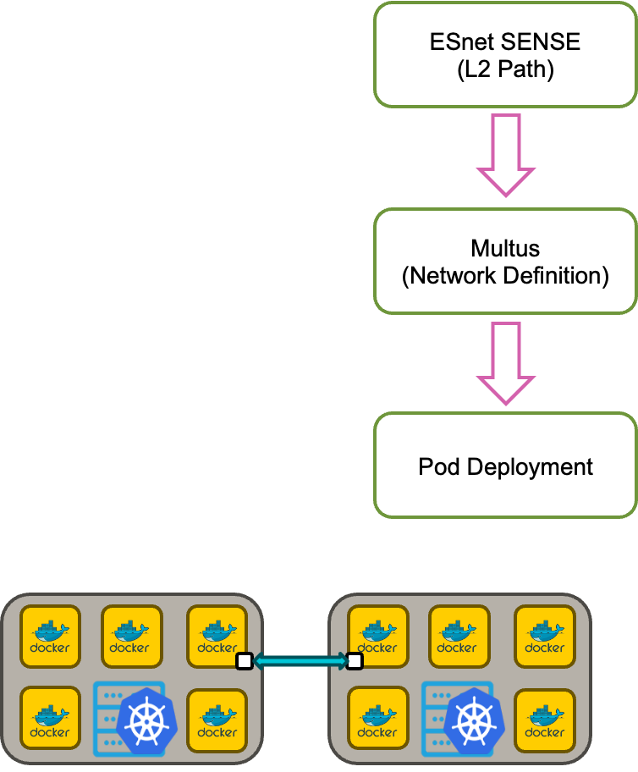
Network Experiments on Nautilus
SENSE Path Provisioning
Establish L2 path between Nautilus nodes using ESnet SENSE.
SENSE dynamically configures VLAN interfaces across multi-domain networks.
Once configured, SENSE creates and activates VLAN network interfaces on the nodes involved in the experiment.
Multus Network Definition
Multus CNI enables pods to have multiple network interfaces beyond the default.
A NetworkAttachmentDefinition (NAD) is created for the VLAN interfaces provisioned by SENSE.
Specifies the VLAN network (e.g., vlan-10).
Connects the pods to the configured L2 path.

Slide 38
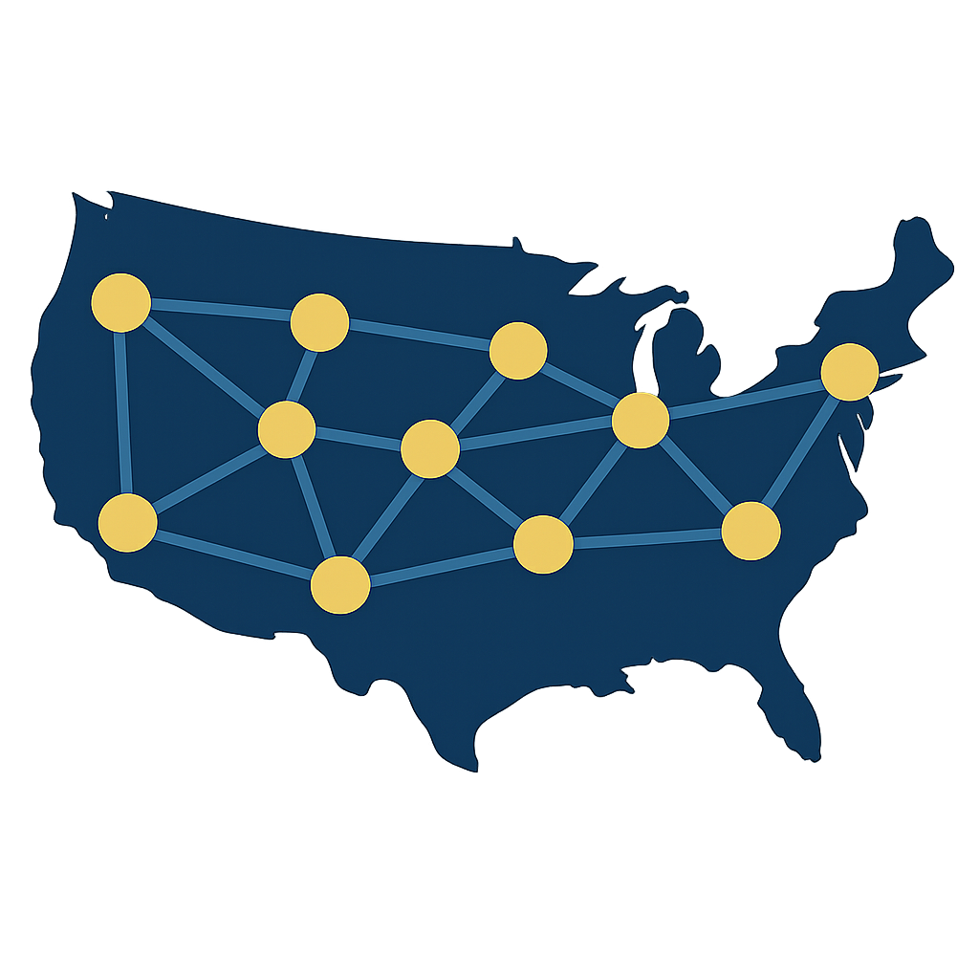
The AutoGole/SENSE Topology
National Research Platform Fall Training Series

Slide 39
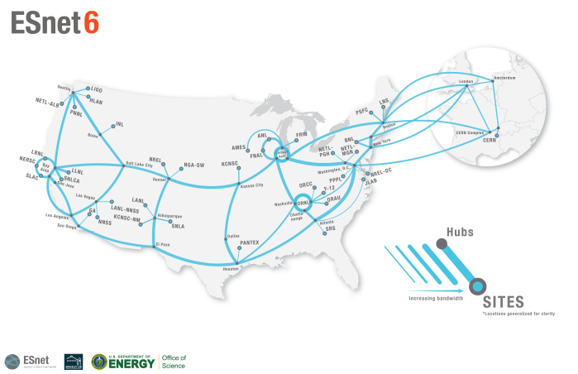
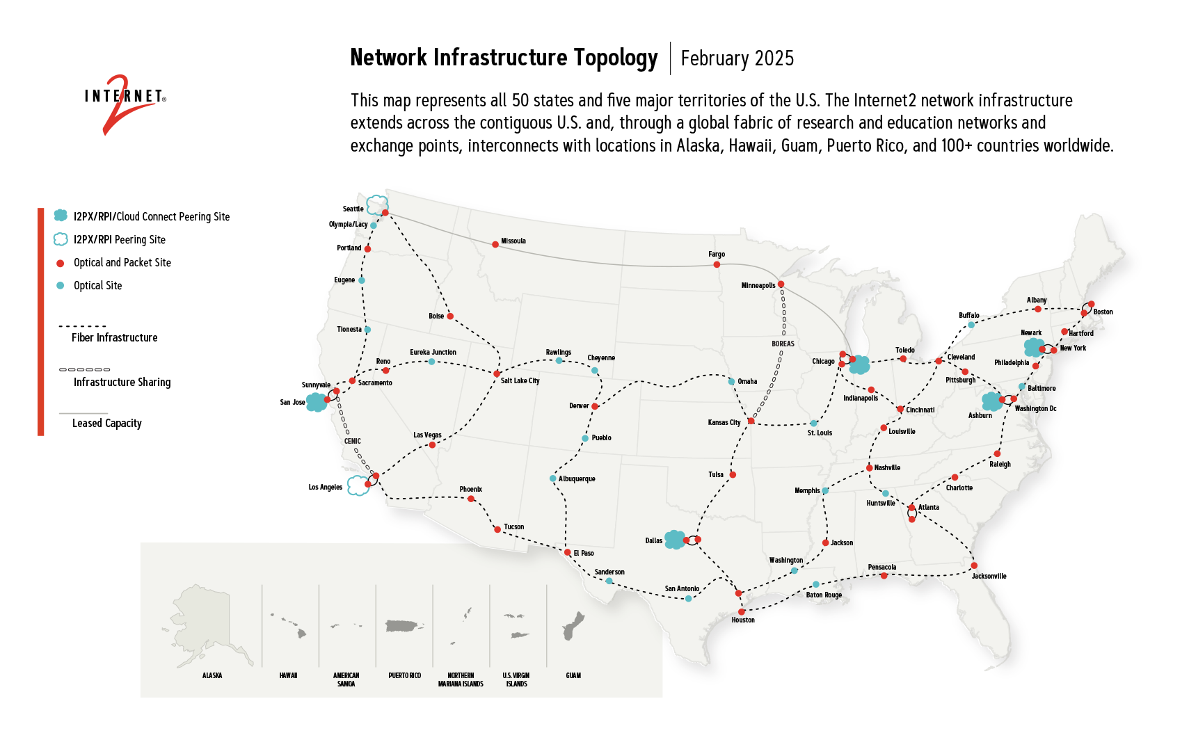
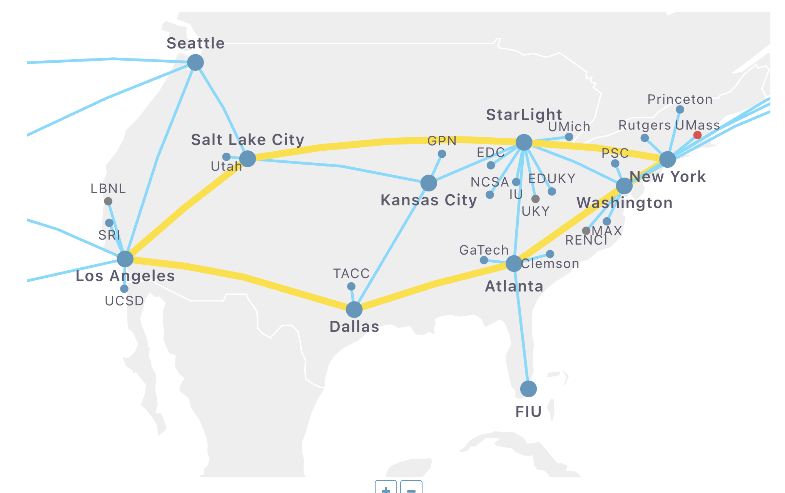
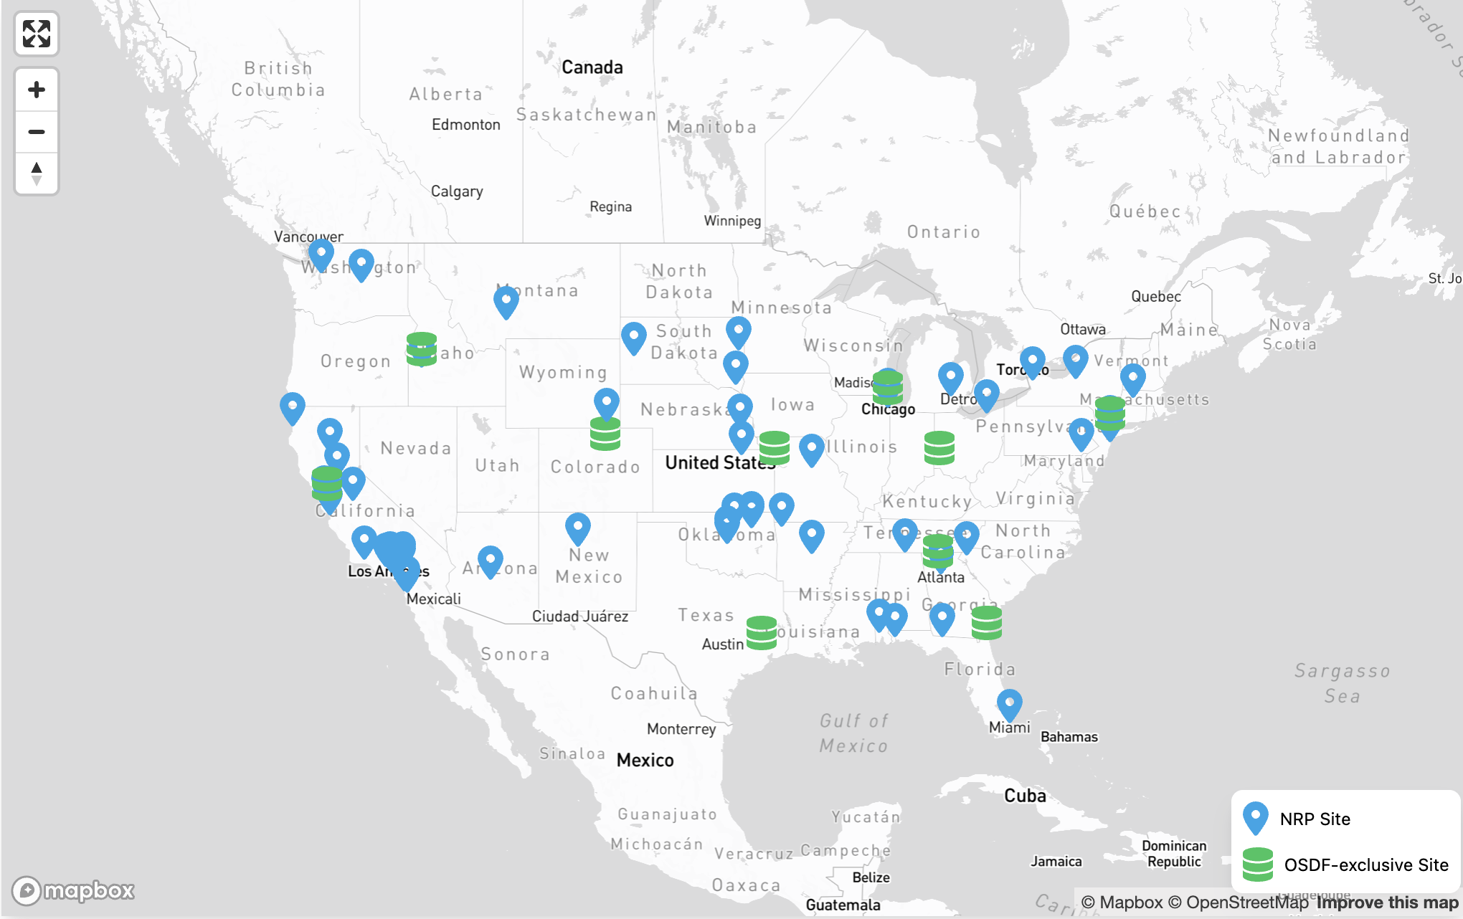

Slide 40
ESnet SENSE
Software-Defined Network for End-to-End Networked Science at Exascale
Network management system designed to provide tailored and reliable network services for scientific applications.
Offers scalable approach to network management.
Enables customized end-to-end service provisioning (L2 and L3) across complex and distributed infrastructures.

Slide 41
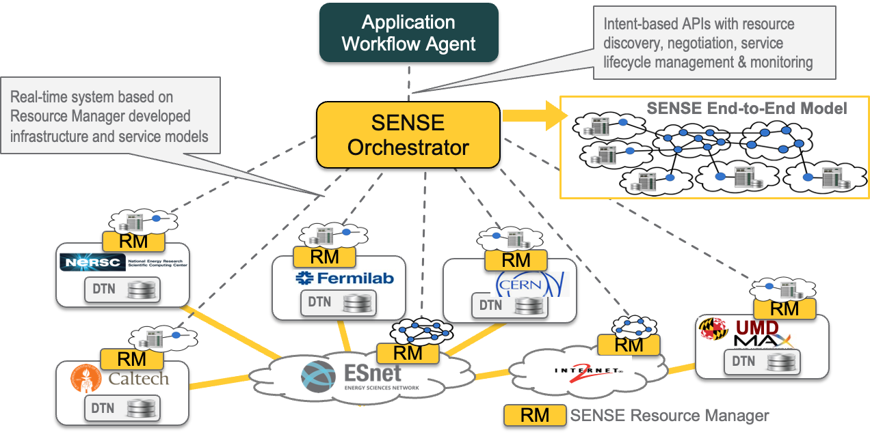
ESnet SENSE

Slide 42
The K8s SENSE Operator
The SENSE Operator allows users to declare a network path using a custom Kubernetes resource: SensePath.
apiVersion: sense.nrp-nautilus.io/v1alpha1
kind: SensePath
metadata:
name: n26-to-n27
spec:
uri1: "node-2-6.sdsc.optiputer.net:enp65s0f1np1"
uri2: "node-2-7.sdsc.optiputer.net:enp65s0f1np1"
bandwidth: 1000
vlan_tag: 3115
…
kind: Pod
…
annotations:
sense.nrp-nautilus.io/target-node: "node-2-7.sdsc.optiputer.net"
sense.nrp-nautilus.io/bandwidth: "1000"
…
nodeSelectorTerms:
- matchExpressions:
- key: kubernetes.io/hostname
operator: In
values:
- node-2-6.sdsc.optiputer.net
…

Slide 43
The K8s SENSE Operator
…
kind: Pod
…
annotations:
sense.nrp-nautilus.io/target-node: "node-2-7.sdsc.optiputer.net"
sense.nrp-nautilus.io/bandwidth: "1000"
…
nodeSelectorTerms:
- matchExpressions:
- key: kubernetes.io/hostname
operator: In
values:
- node-2-6.sdsc.optiputer.net
…
Node 1
Bandwidth
Node 2
Start k8s SensePath CRD
Start SENSE Path
Update Status in SensePath
Create Multus NADs
Patch annotated pods
Delete path in 7 days unless extended

Slide 44
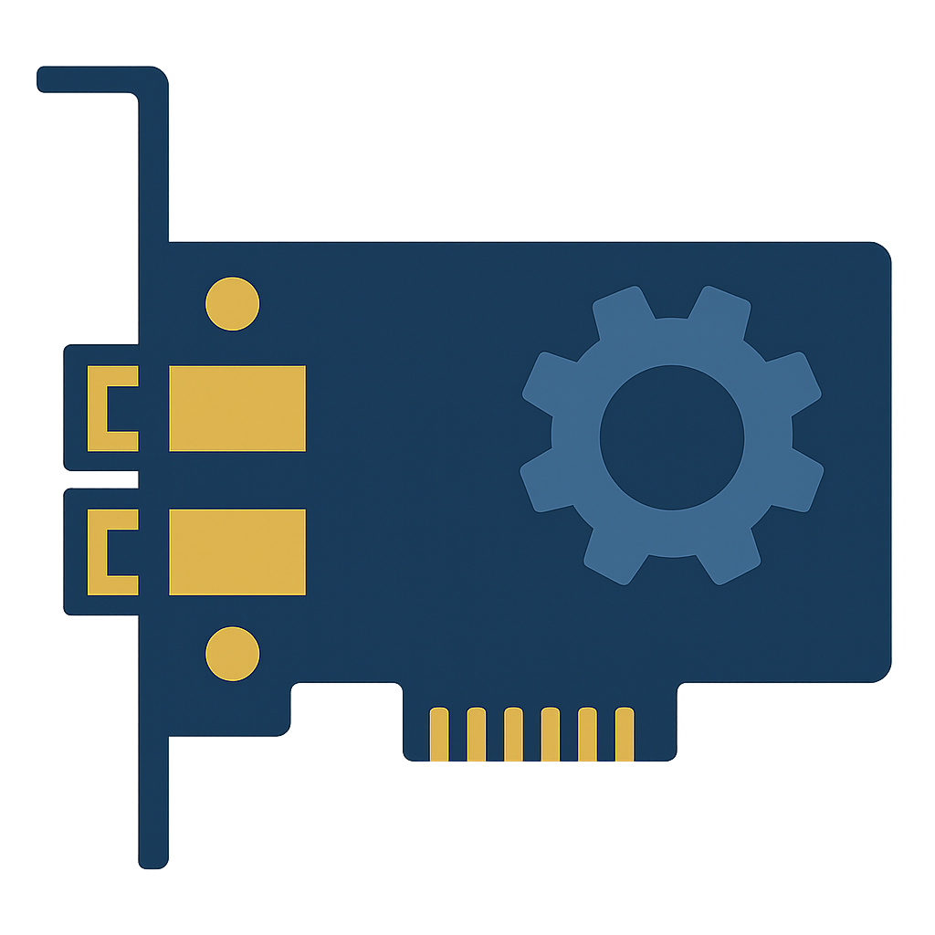
FPGAs & SmartNICs
National Research Platform Fall Training Series

Slide 45
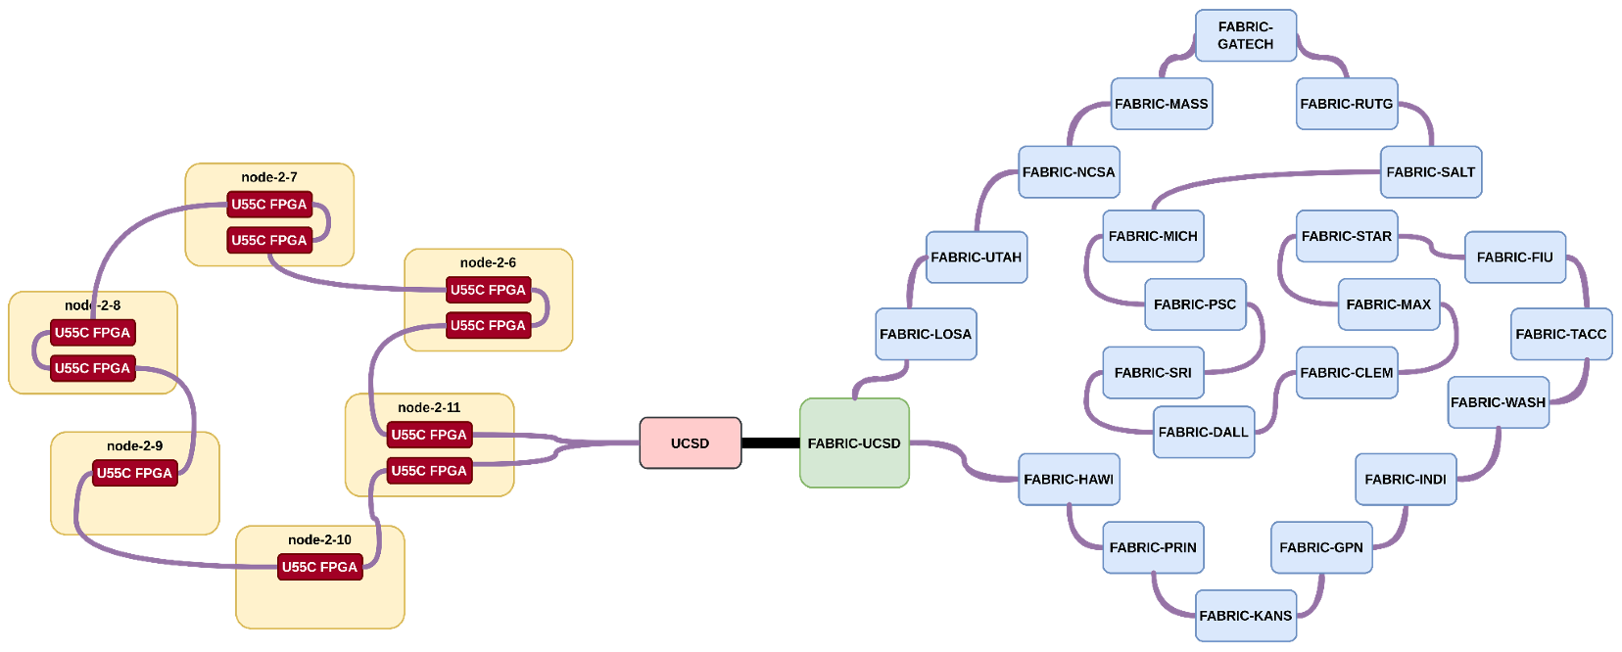
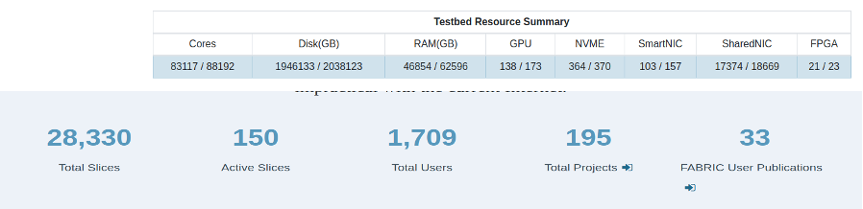
Testbed Integration
The FABRIC testbed is a research infrastructure designed to support networking and computing experiments.
It provides a platform for designing, deploying, and testing large-scale network experiments and services.
FABRIC offers network and compute resources, including connections and virtualized environments.

Slide 46
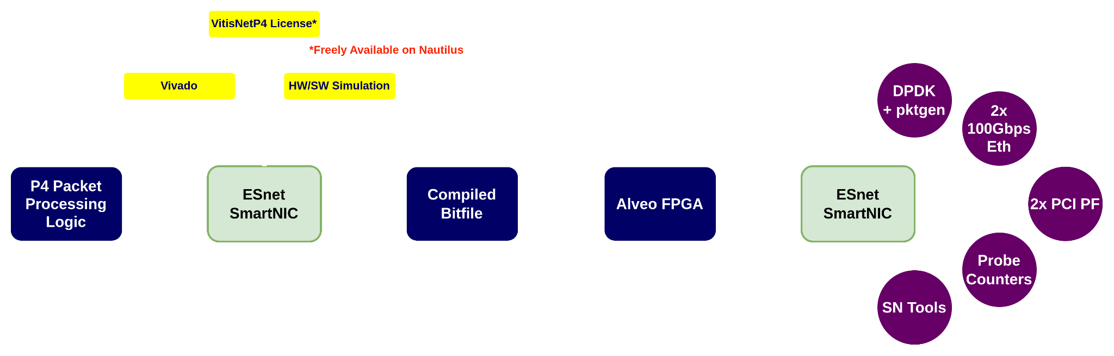

ESnet SmartNICs
Uses Xilinx Alveo FPGAs (U280 & U55C) to enhance network processing via SmartNICs.
Advantages:
Custom Logic: Flexible, tailored P4 processing.
Enhanced Control: cli for control plane operations.
Testing: Probe counters and DPDK/pktgen.

